Slide 1
What is Gas Buddy?

Slide 2
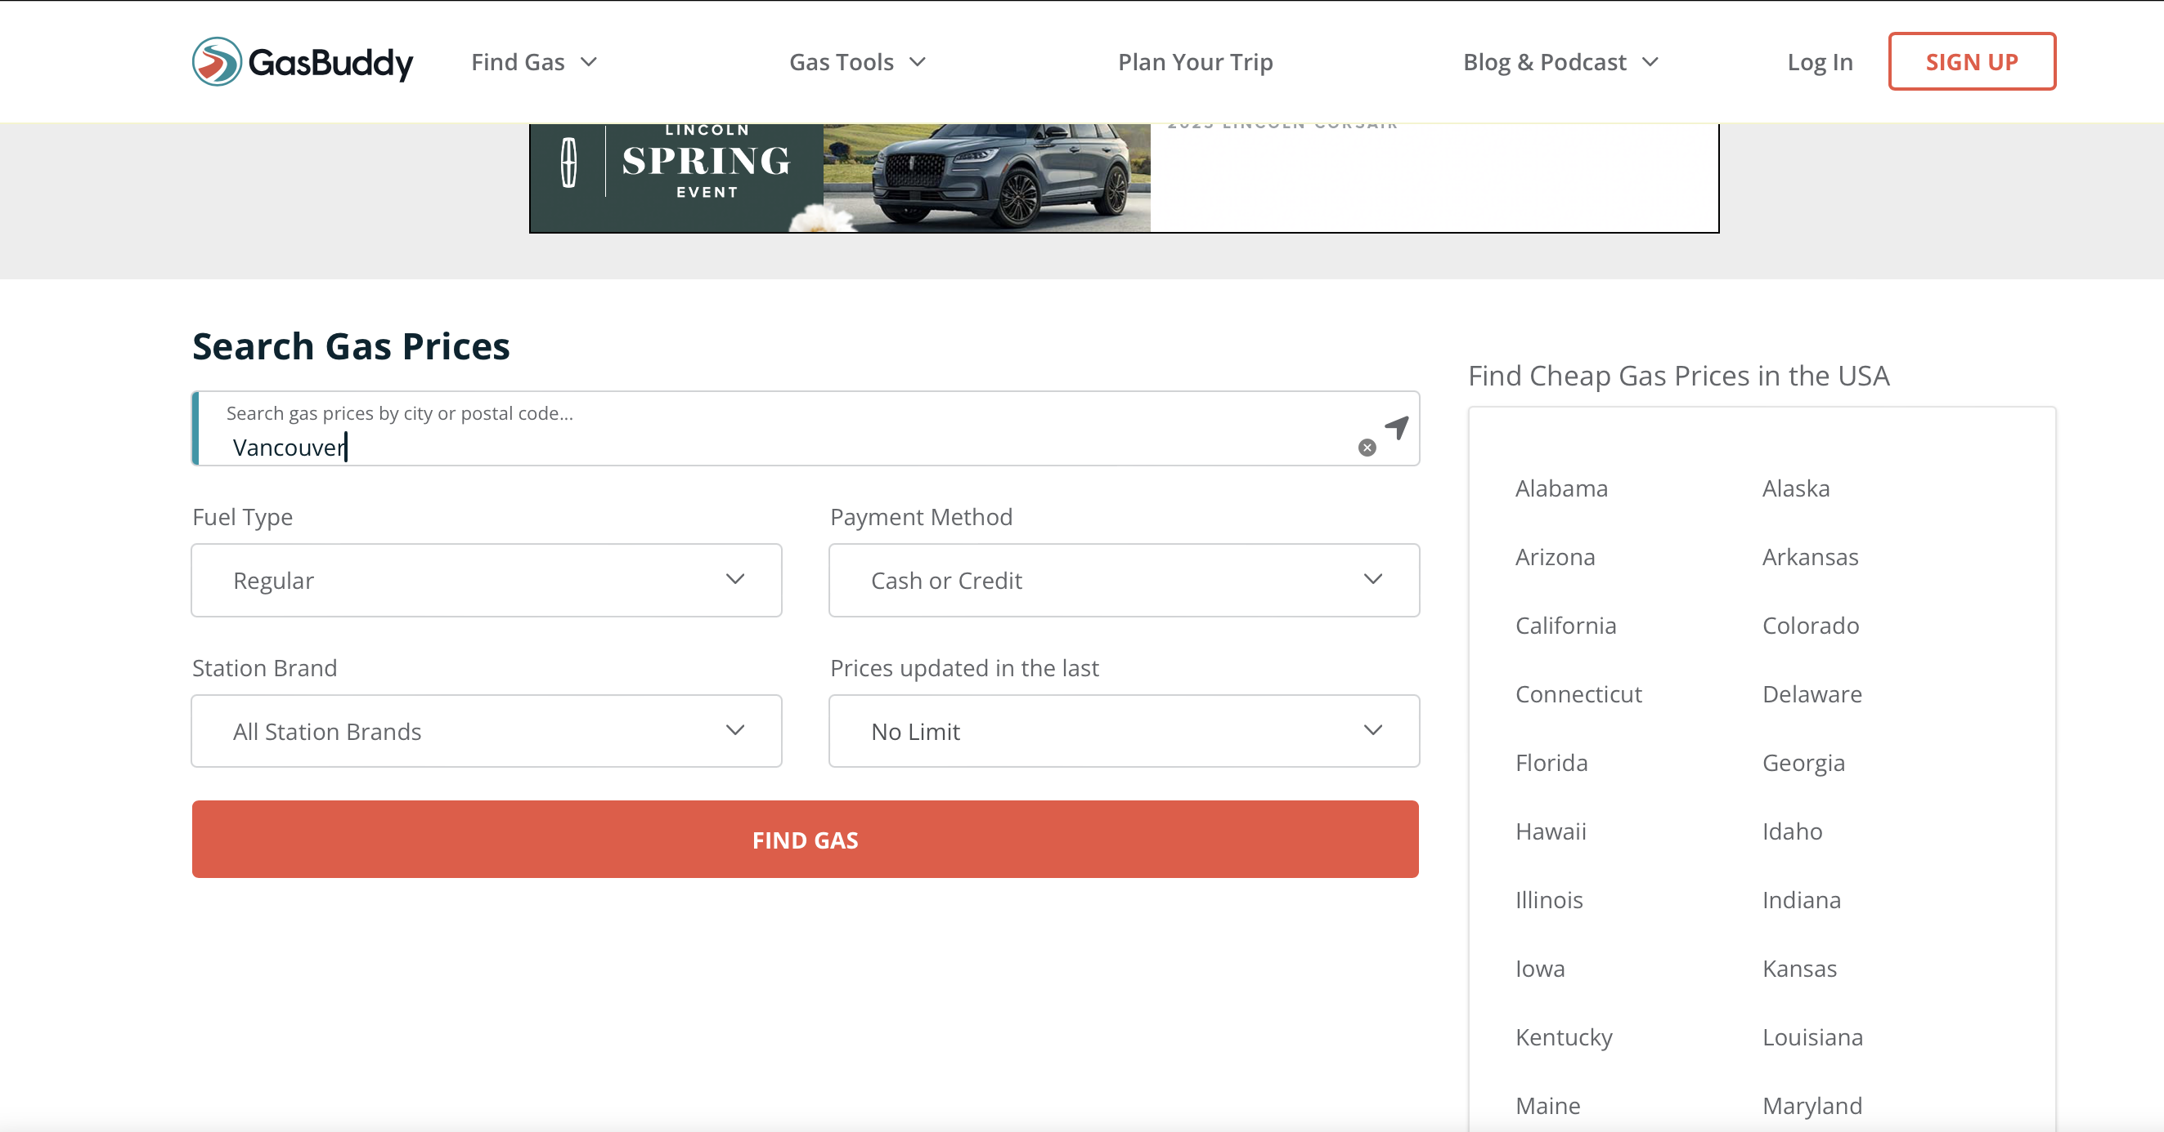
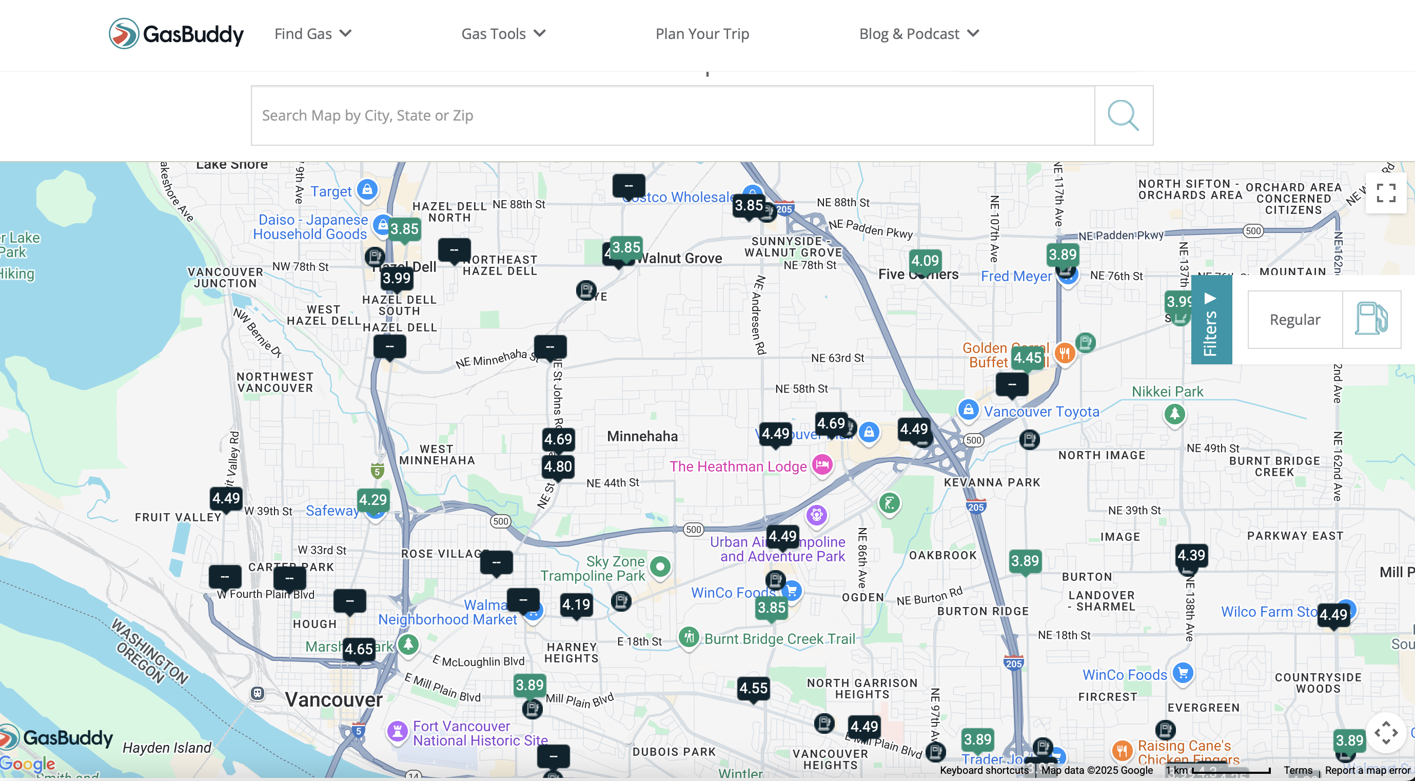
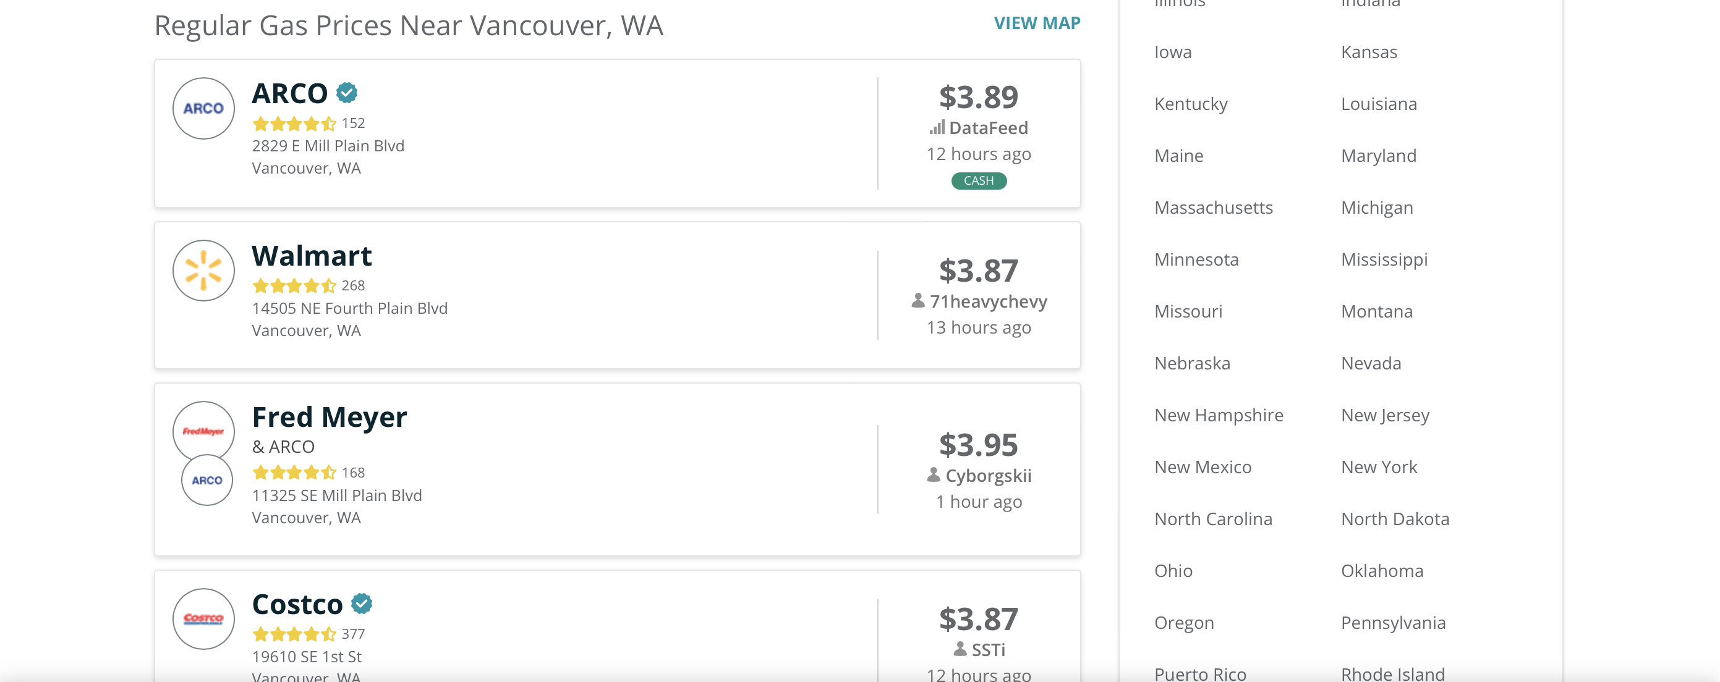

Slide 3
Project Overview
Gas Price Analysis Pipeline
Three Python scripts:
scrape_gasprice.py
clean_data.py
visualization.py
Two Shell scripts:
autorun.sh
check_time.sh
Automation:
Shortcut (MacOS)+ shell scripts
Dependencies:
asyncio, logging, pandas, datetime, time
gasbuddy, matplotlib, folium, branca, plotly

Slide 4
Visualization Output
Time Series Plot
Scatter Plot
Heatmap

Slide 5
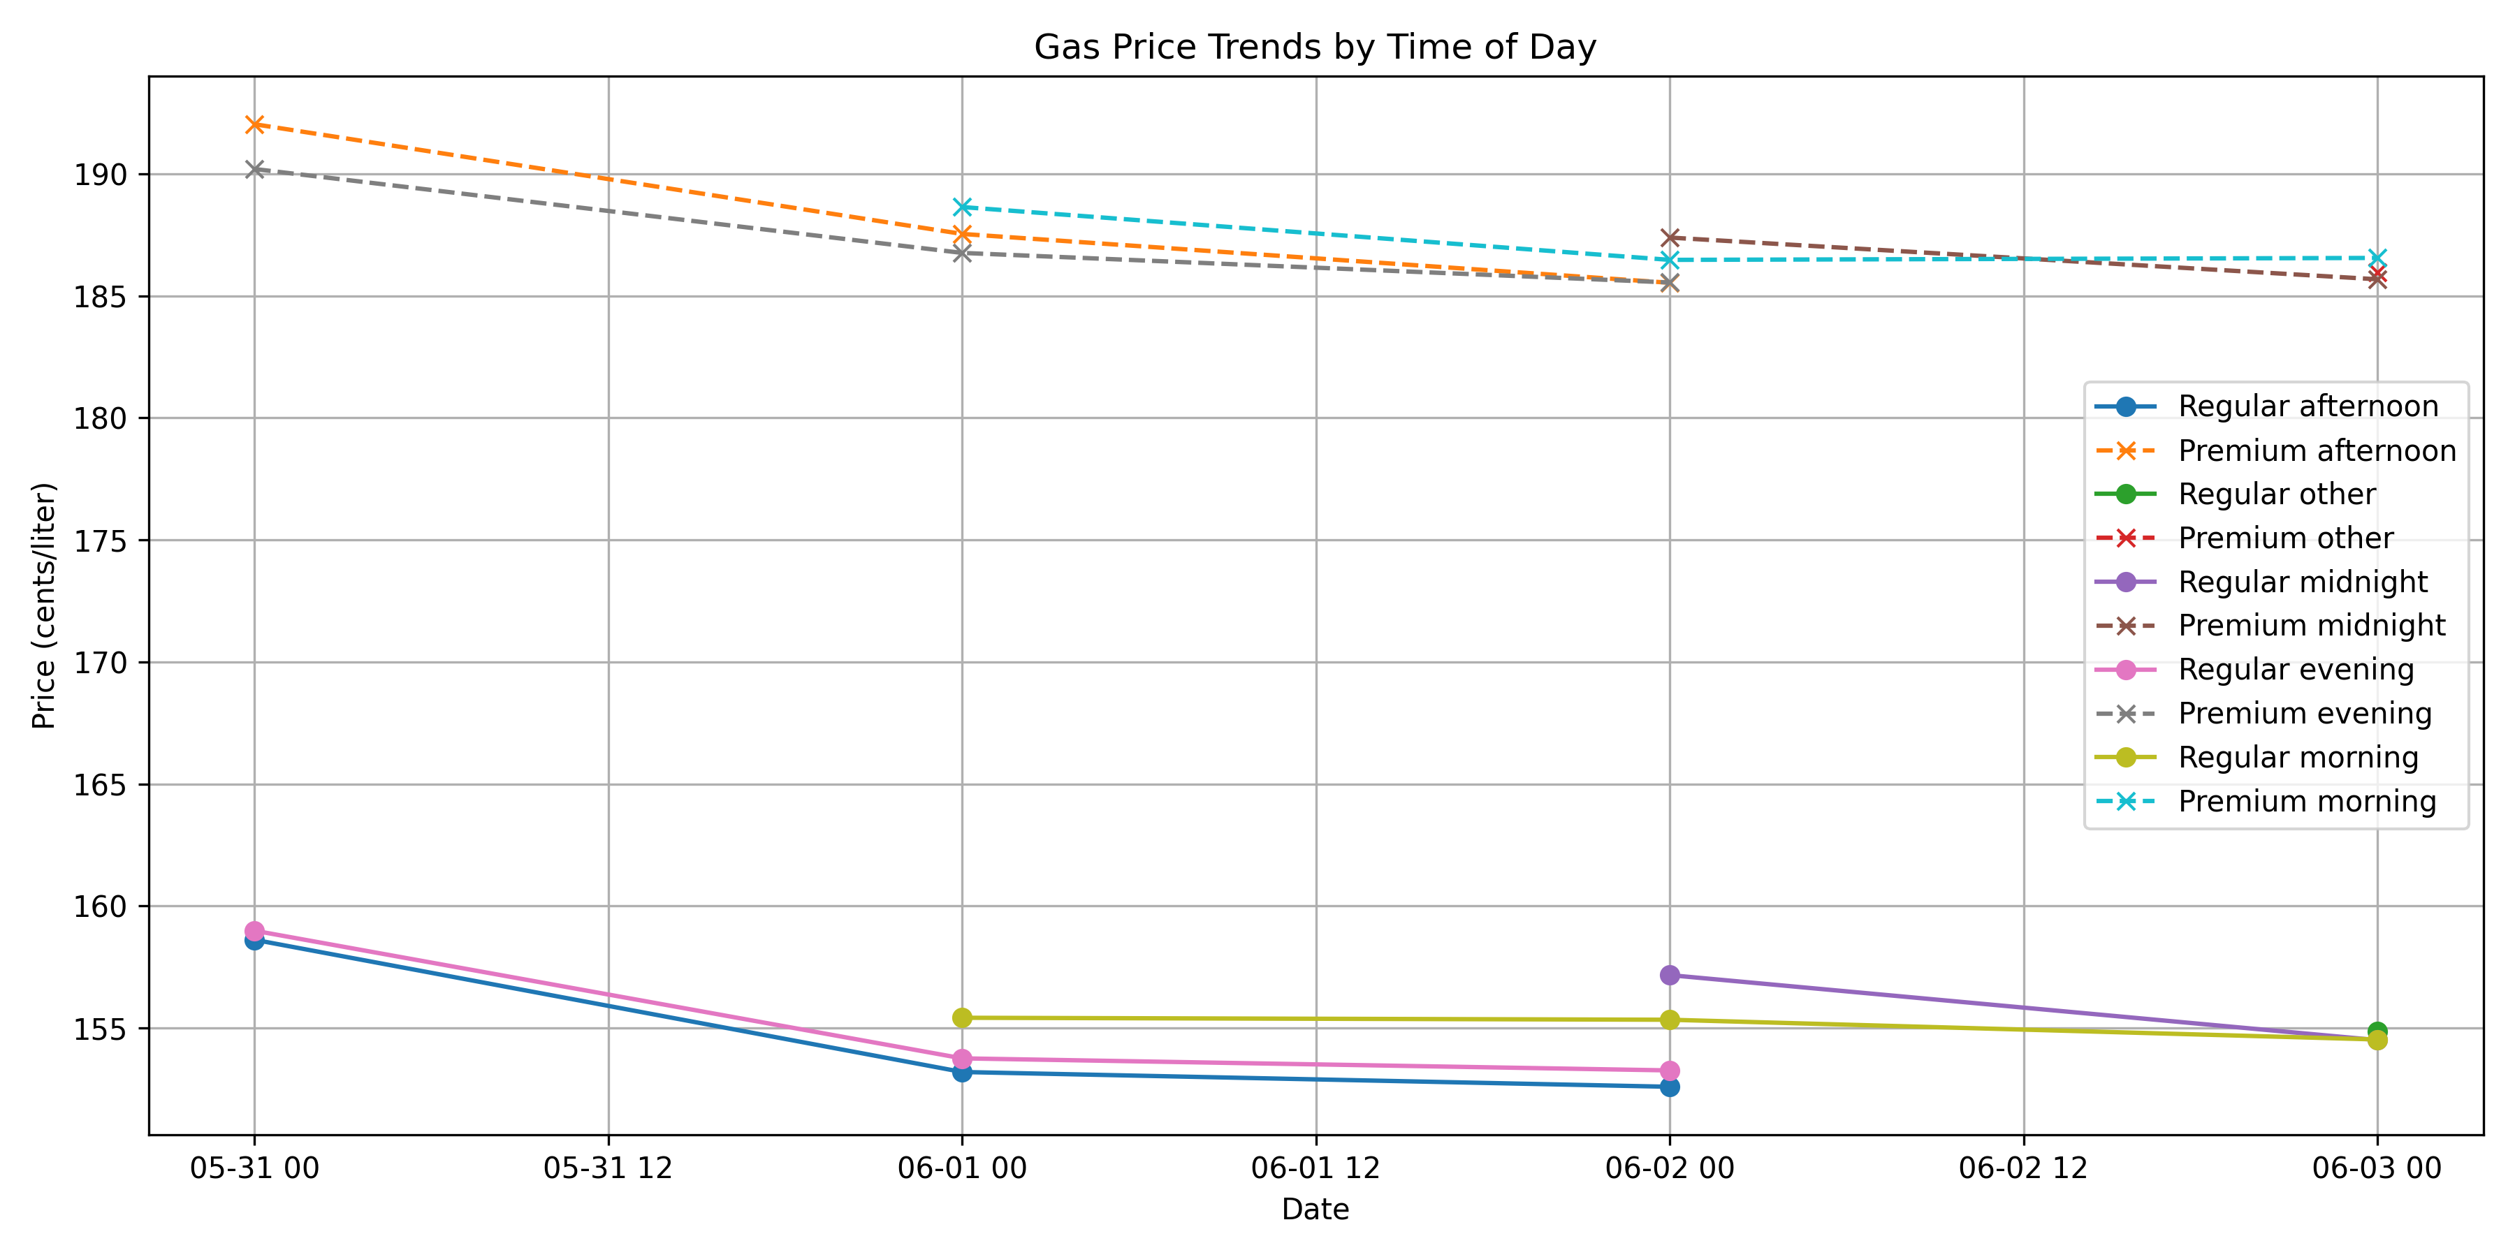

Slide 6
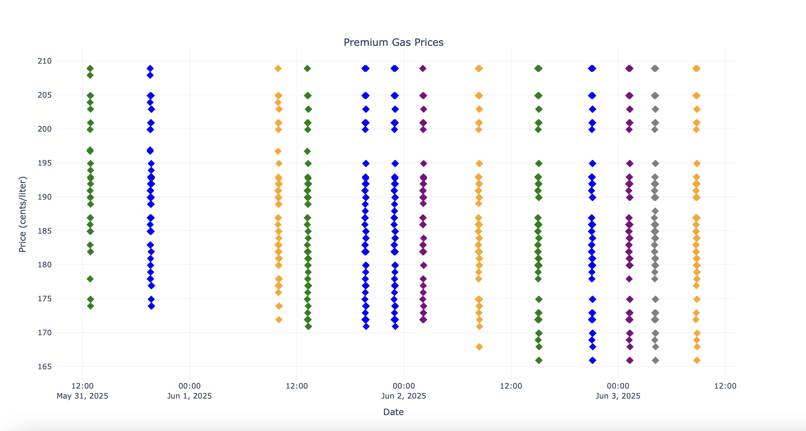
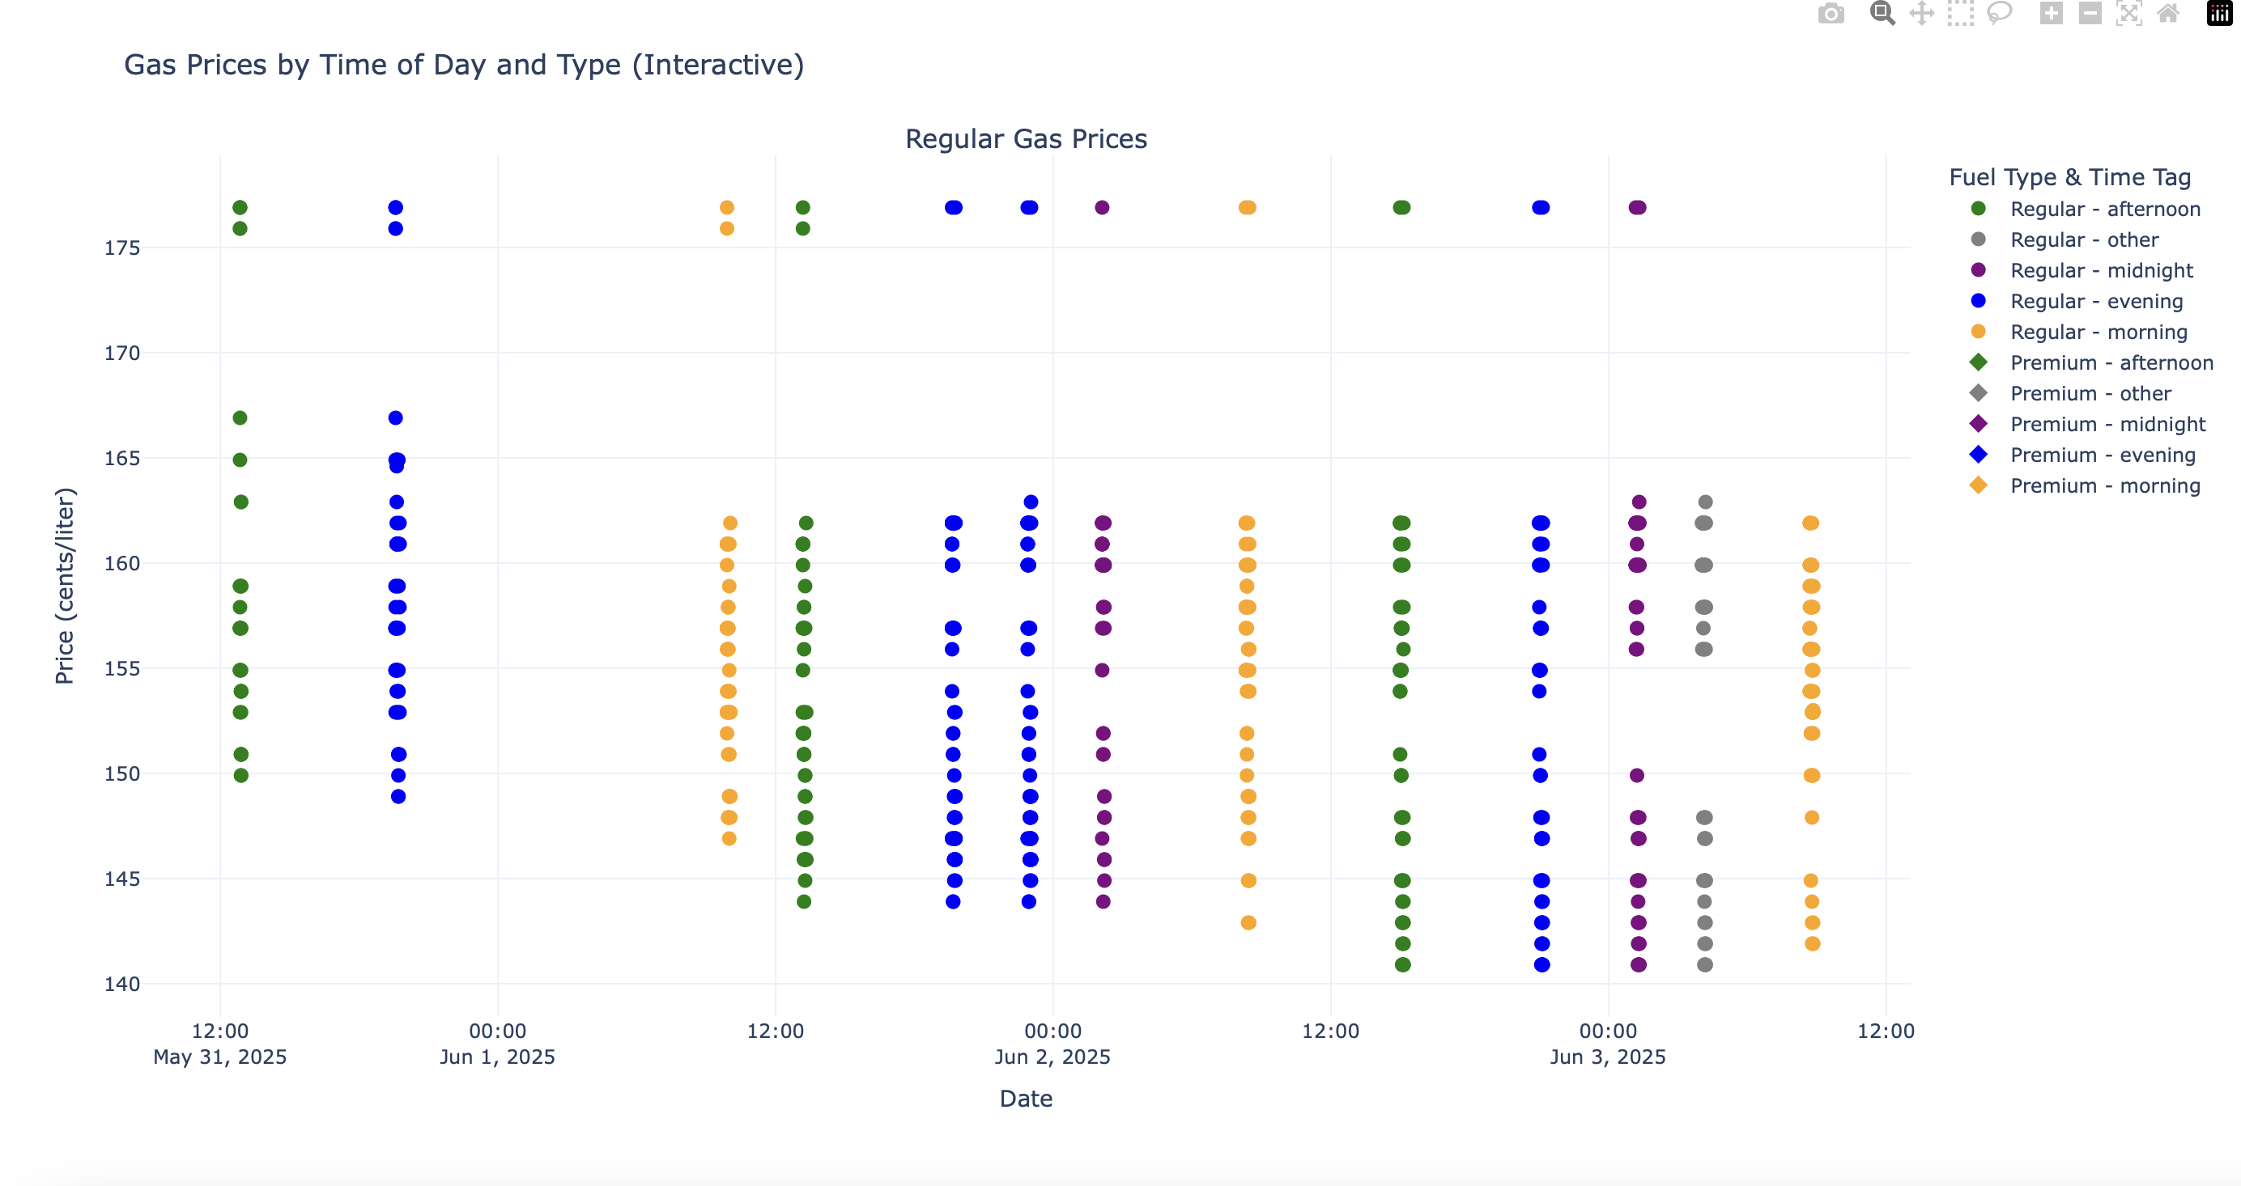

Slide 7
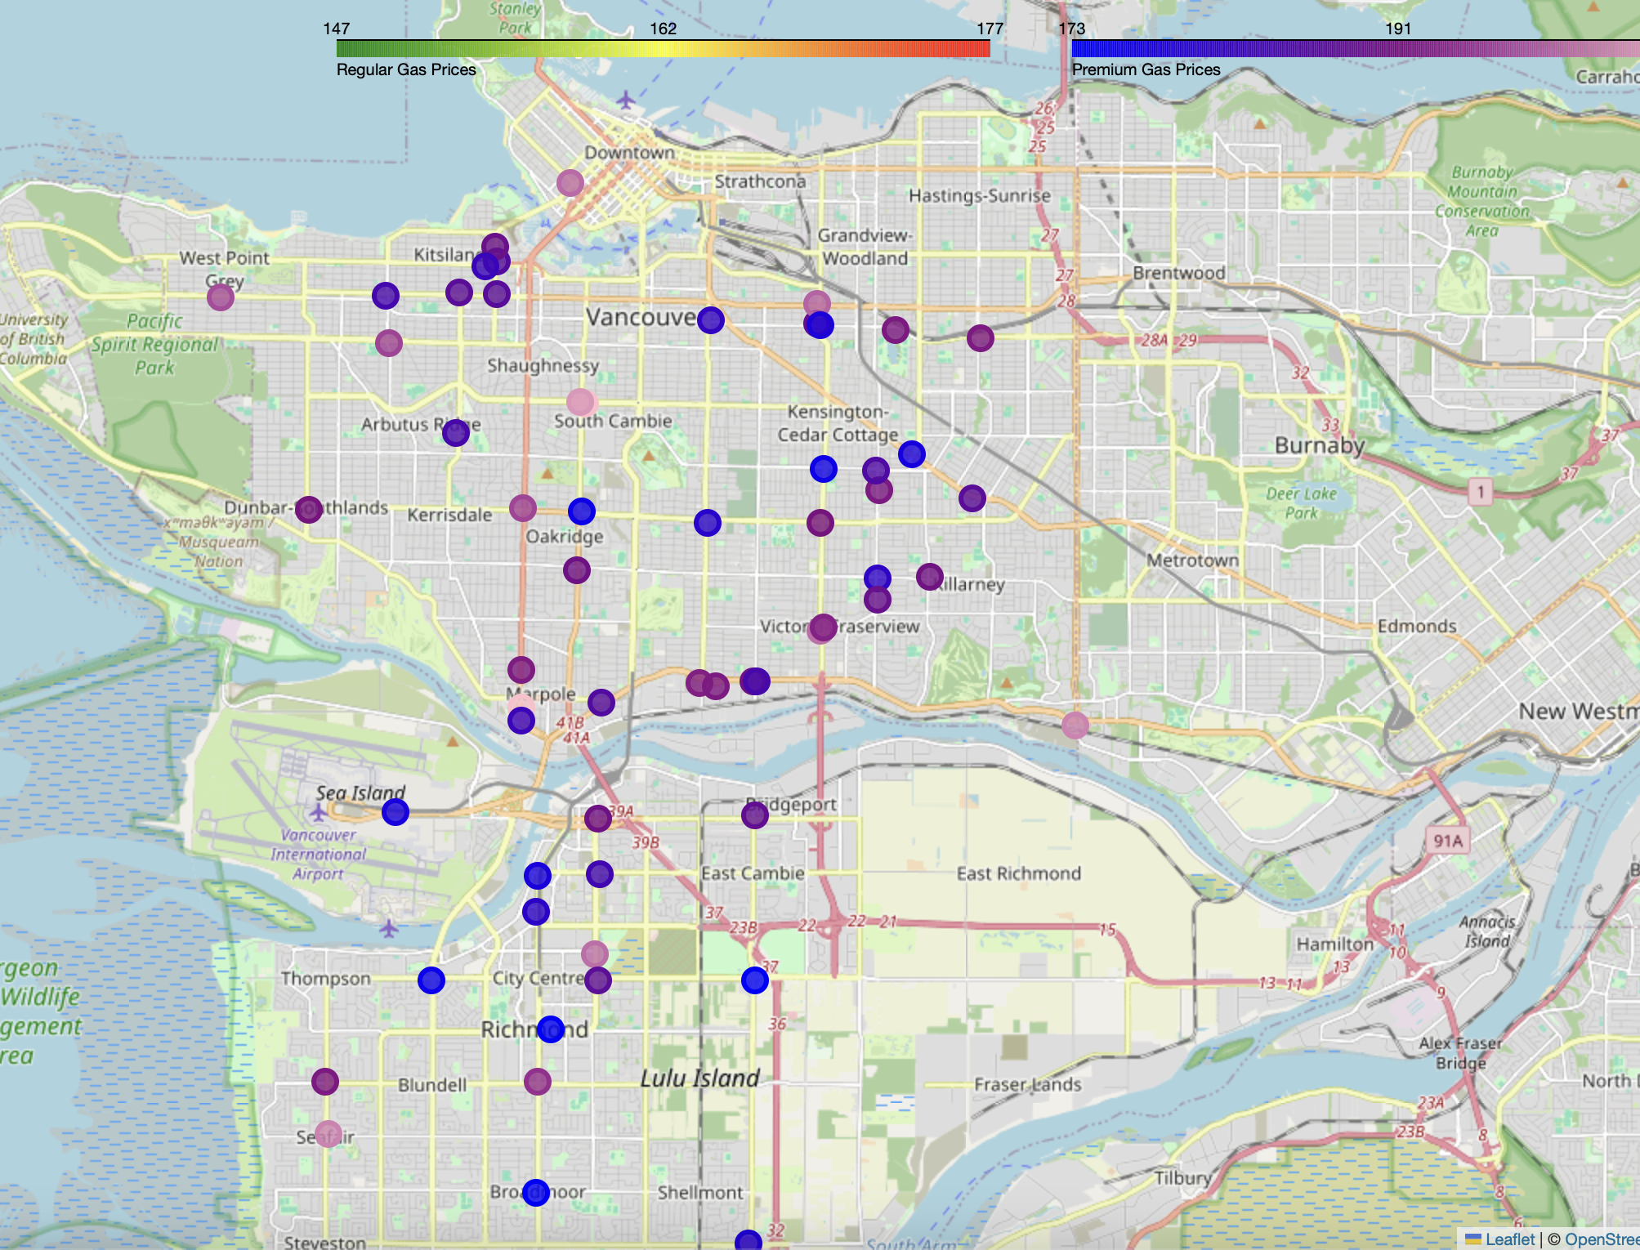
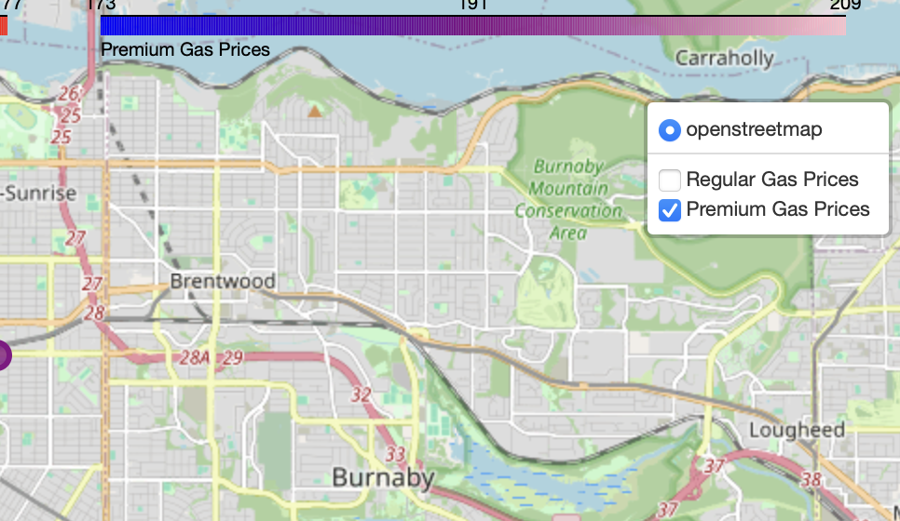
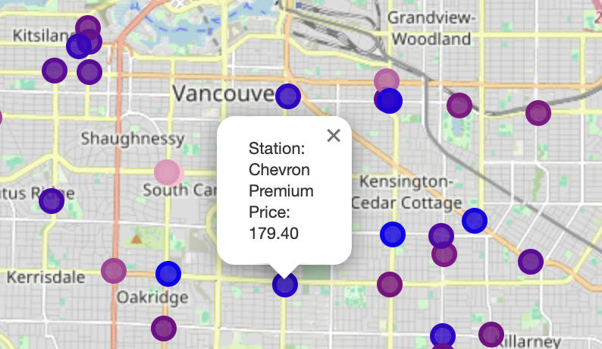
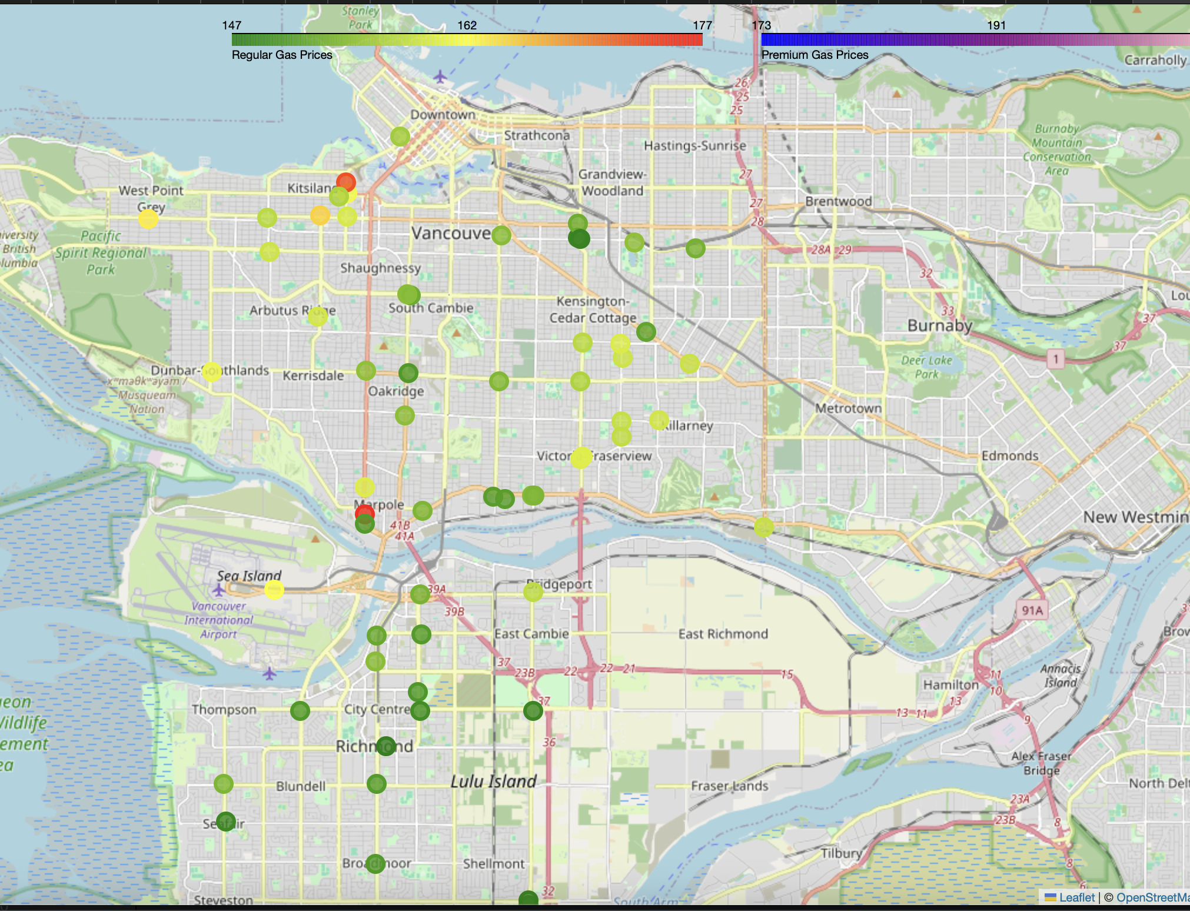

Slide 8
Pipeline Overview
Overview:
1. scrape_gasprice.py: Collects gas price data.
2. clean_data.py: Cleans and deduplicates the data.
3. visualization.py: Produces visual insights.
Note:
Logs at ./log/debug_log.txt
gas_prices.xlsx grows over time — archive regularly
Time Tags: morning, afternoon, evening, midnight
Heatmap clips extreme values
Challenges:
API rate limits

Slide 9
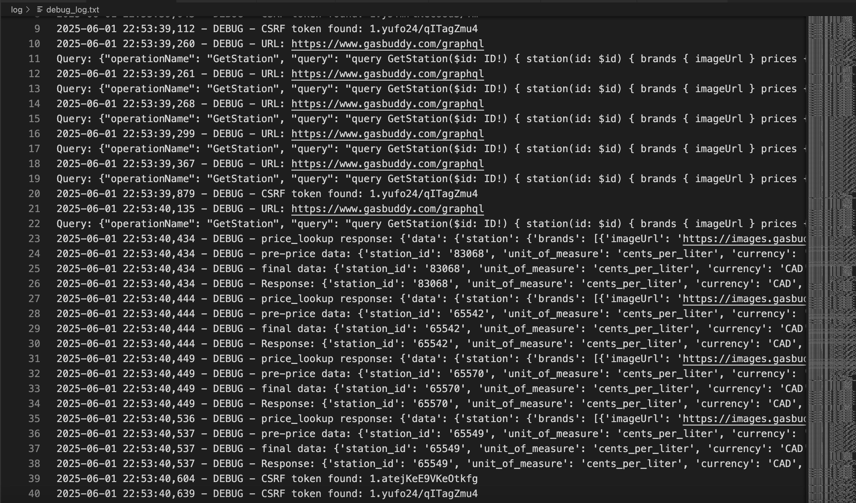
scrape_gasprice.py
Retrieves gas station data using GasBuddy API.
Saves data to gas_prices.xlsx.
Uses asyncio for async API calls.
Extracts station data.
Logs operations.
Rate-limit friendly: 60s delay between queries for each location.

Slide 10
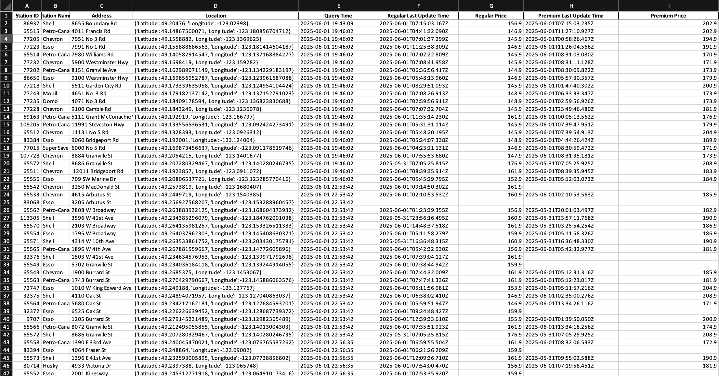
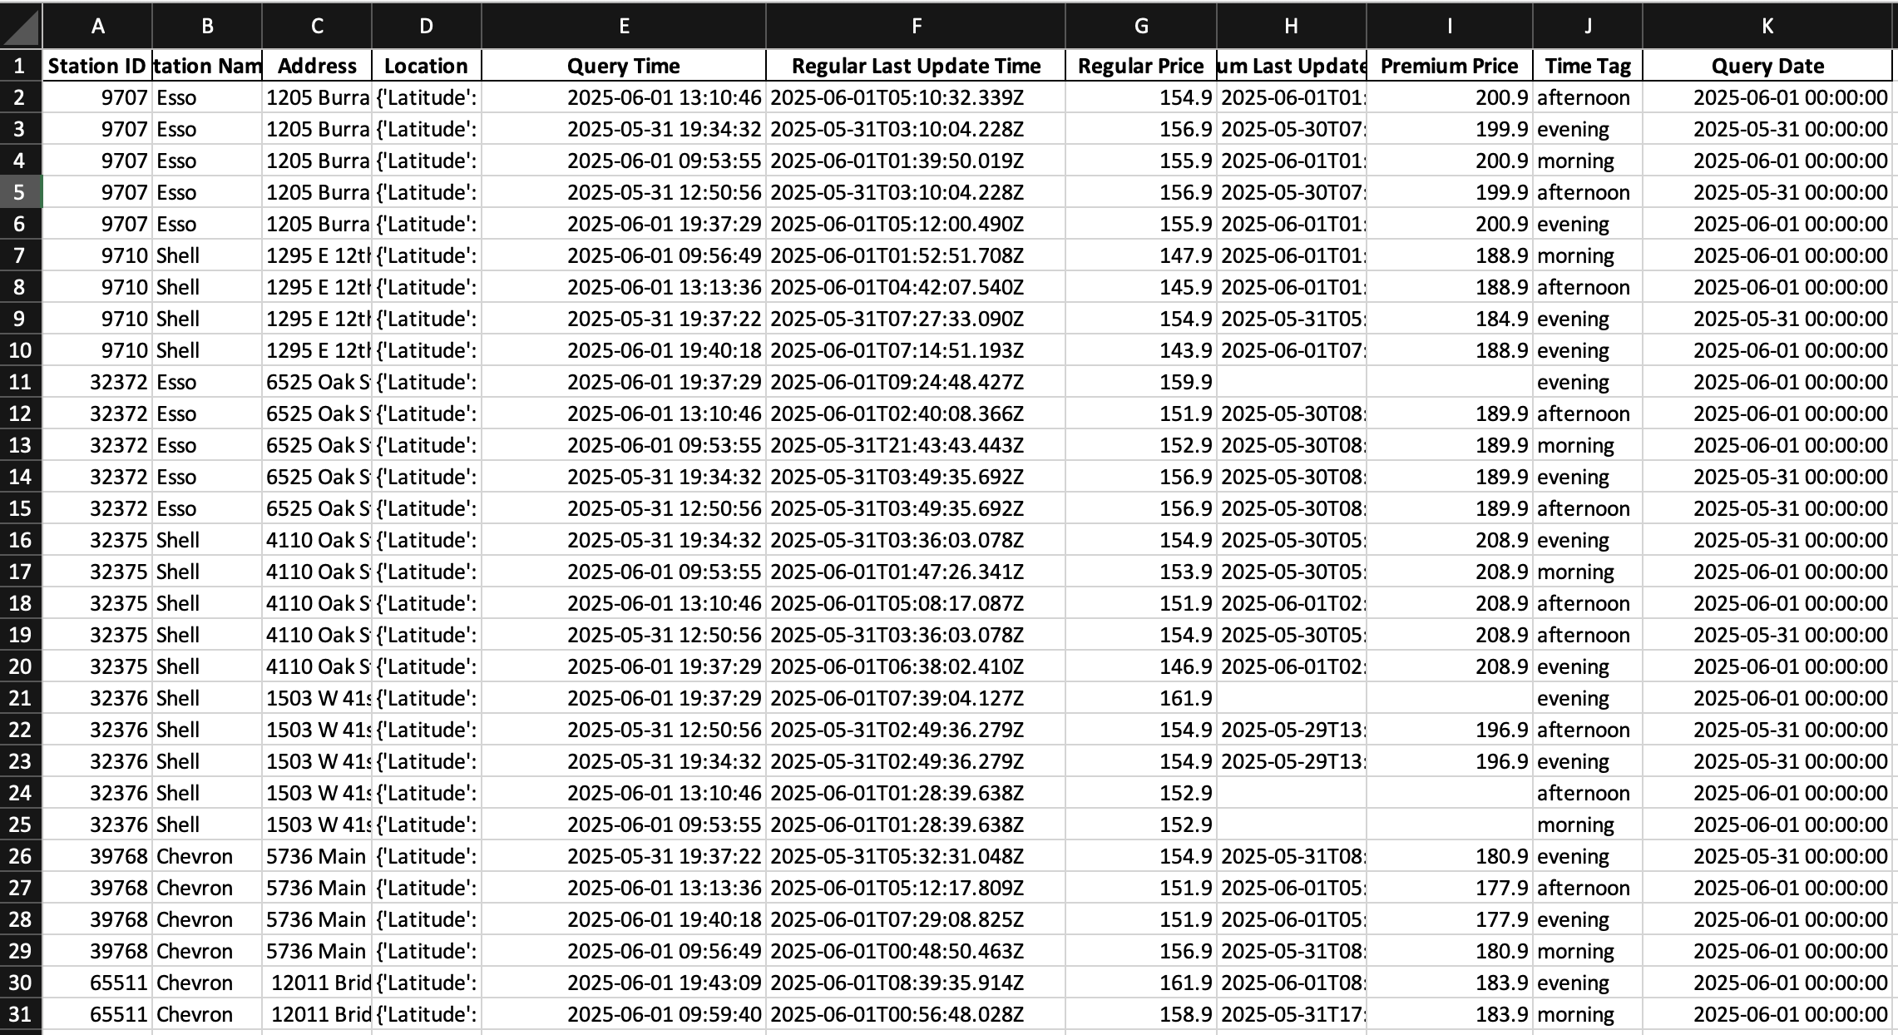
clean_data.py
Cleans raw data from gas_prices.xlsx.
Filters invalid records.
Tags by time-of-day.
Removes duplicates.

Slide 11
visualization.py
Time-Series Plot:
Price trends over time on Average
Interactive Time Plot:
Scatter plot of all data points
Geographic Heatmap:
Interactive map of gas stations
Colour codes the average price of all recorded gas stations
Outputs: time_plot.png and heatmap.html, interactive_graph.html

Slide 12
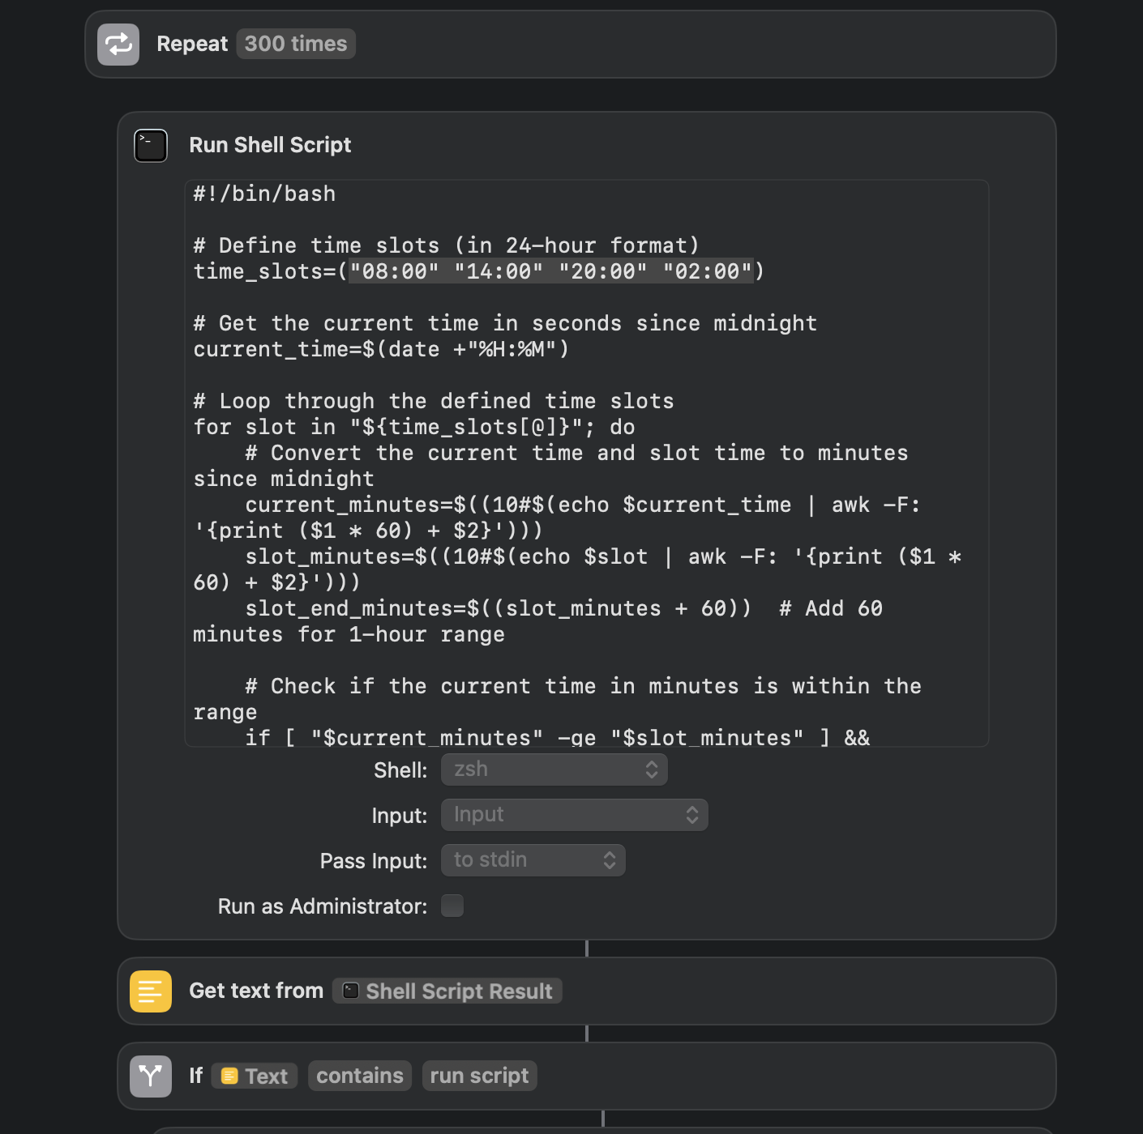
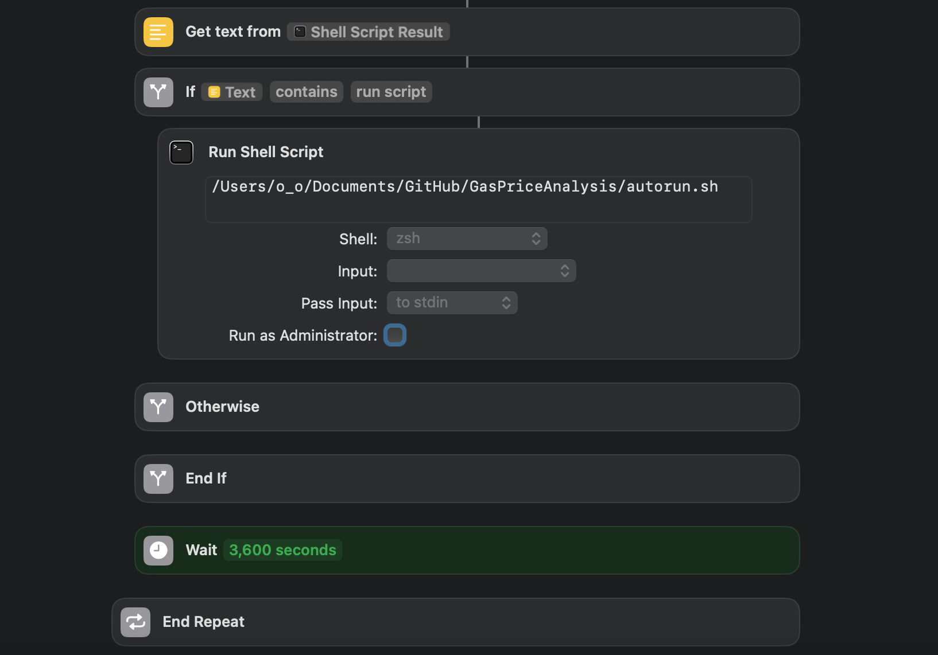
Automatin the Pipeline
check_time.sh + shortcut triggers autorun when in time slot
Shortcut keeps script running in background even when laptop is asleep
autorun.sh handles scheduling for morning, afternoon, evening, and midnight
Run scrape_gasprice.py
Run clean_data.py
Run visualization.py
Shortcut functions are very limited,
but easy get system permission to run while sleep

Slide 13
Thank You

